Slide 1
Magnetic Resonance Image Reconstruction
Melik Mehmet BIYIK
Advisor: Asst. Prof. Ilkay OKSUZ

Slide 2
Content
Introduction
Methods
Results
Future Work

Slide 3
introduction

Slide 4
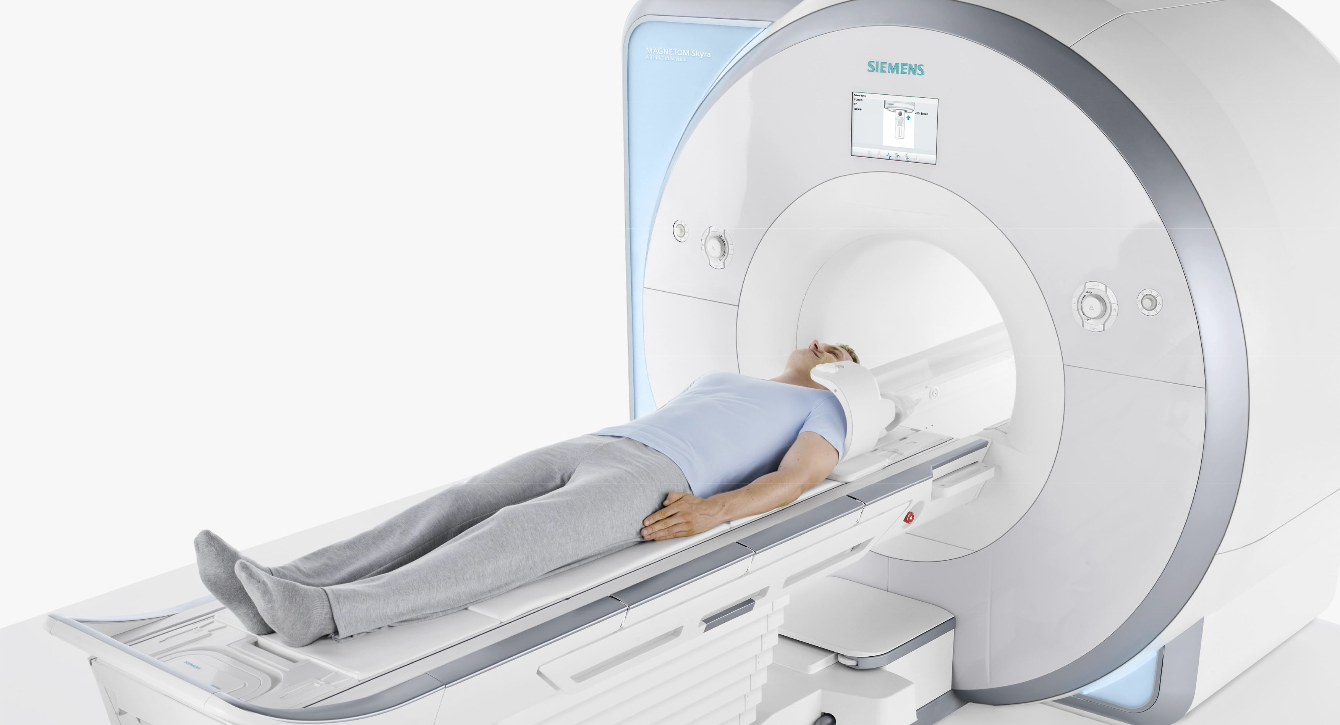
Introduction
Image Reconstruction
Reducing the Magnetic Resonance (MR) acquisition time
The challenge is arranged by University Of Calgary.
Data-set around 200GB https://sites.google.com/view/calgary-campinas-dataset/home?authuser=0

Slide 5
Purpose
The MR acquisition time can easily exceed 30 minutes
Parallel Imaging and Compressed Sensing
Deep Learning methods
Lack of Data

Slide 6
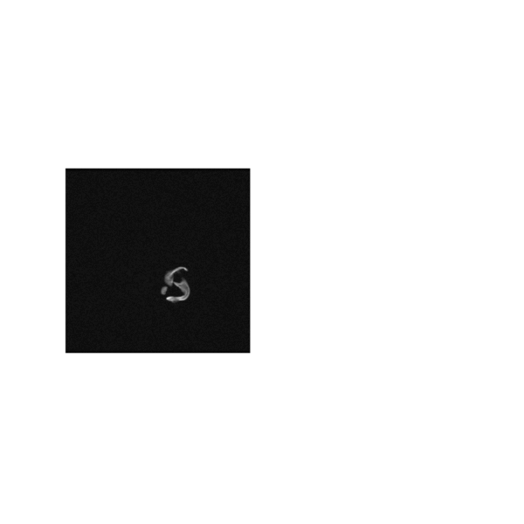
Brain slice MR images

Slide 7
METHODS

Slide 8
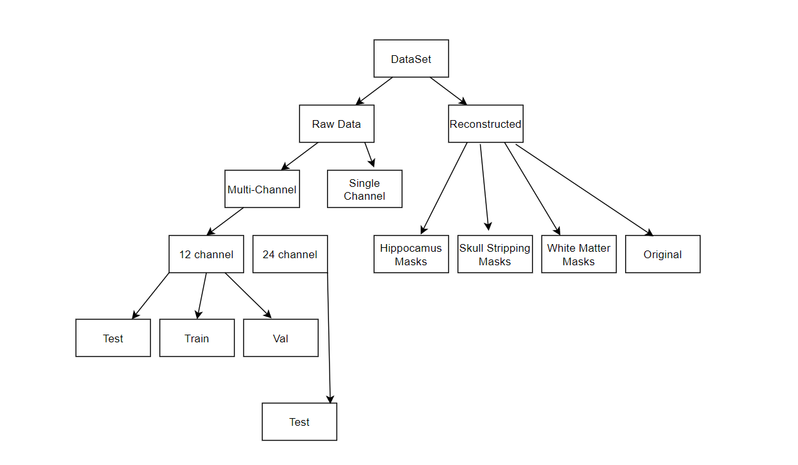
Data-Set

Slide 9
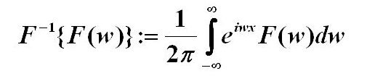
Data-Set
H5 Files
Hierarchical Data Format(HDF)
k-space Fourier Domain
Fourier Transform

Slide 10
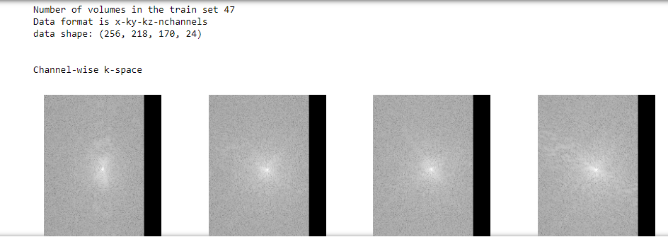
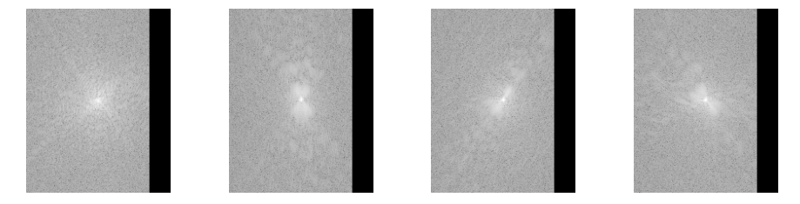
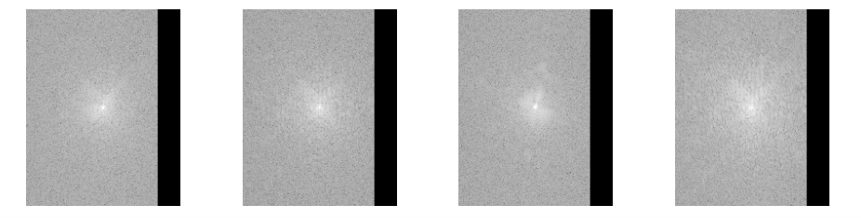
Example 12 channel k-space train data

Slide 11
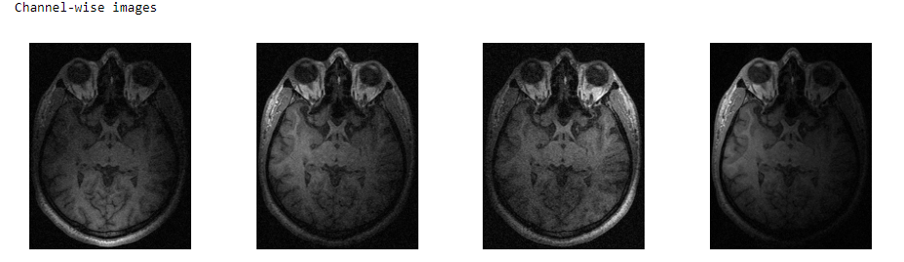
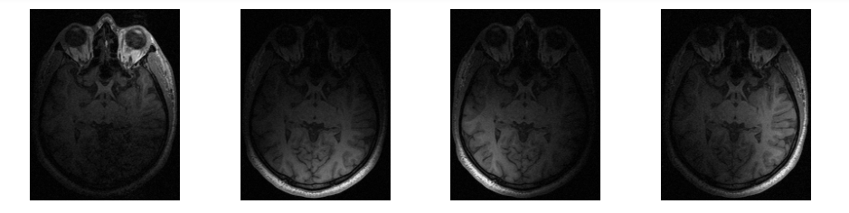
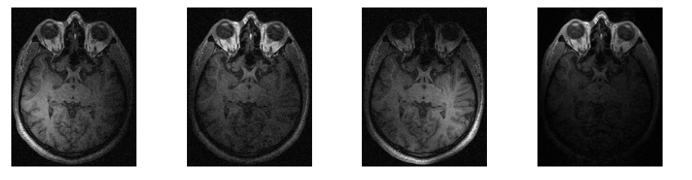
Example 12 channel Brain IMAGES

Slide 12
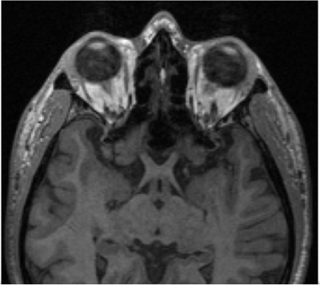
BRAIN IMAGE
Sum_of_square

Slide 13
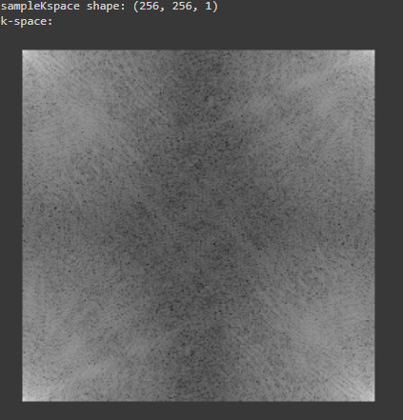
Single-channel data
Numpy Array (.npy)
256x256.
Example plot of the single-channel k-space :

Slide 14
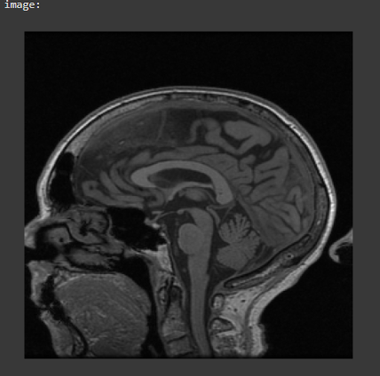
SINGLE-CHANNEL DATA
Inverse Fourier Transform
Example plot of the Single-Channel slice :

Slide 15
Under-Sampling
The mask and data must be in same dimensions
Simulating the speed-up
Mask and data must be in same dimensions

Slide 16
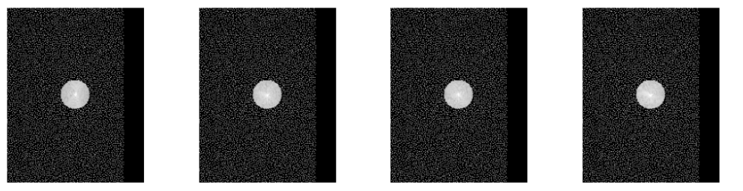
poisson disc MASK
Radius = 16

Slide 17
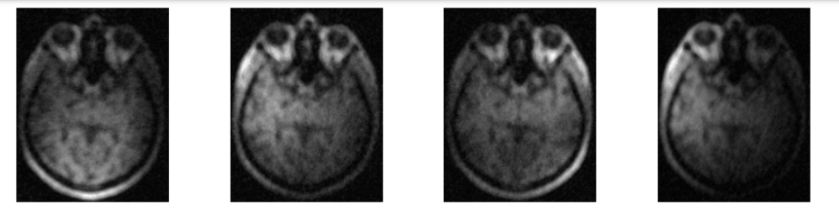
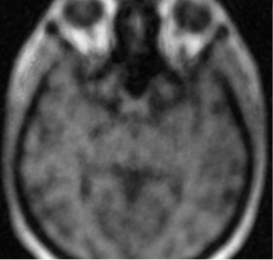
Poisson disc Multi-channel undersampling

Slide 18
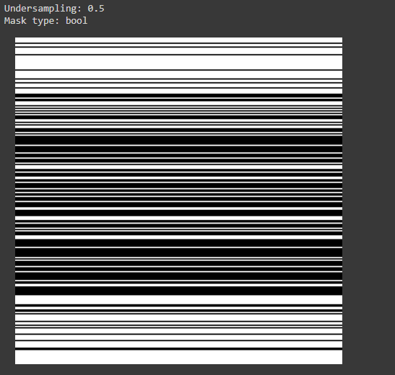
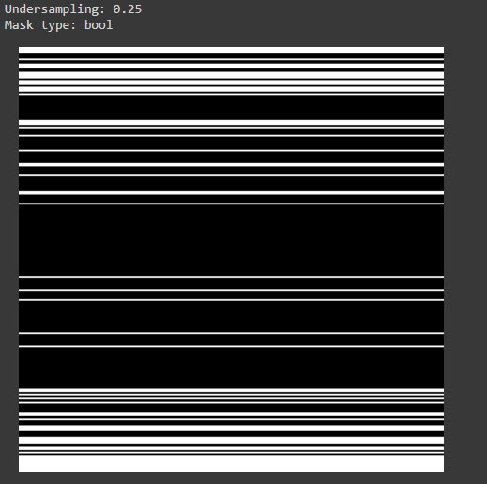
Cartesian mask
Acc: 2 Acc: 4

Slide 19
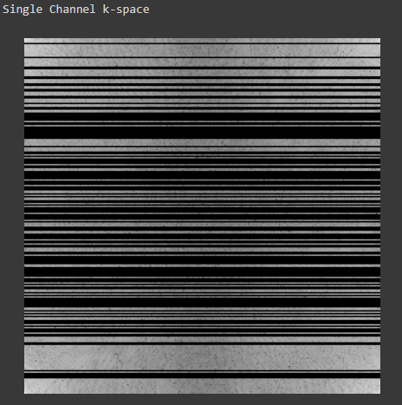
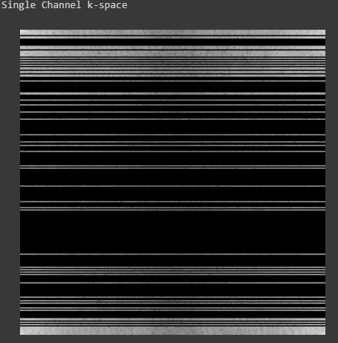
Cartesian mask Under-sampling Single-channel k-space

Slide 20
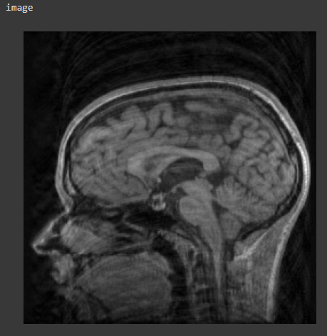
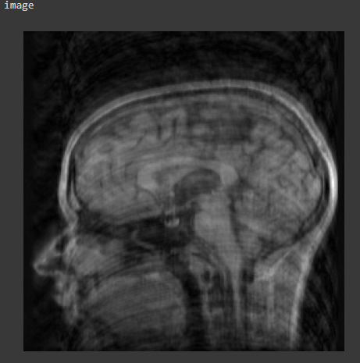
Cartesian mask Under-sampling Single-channel k-space

Slide 21
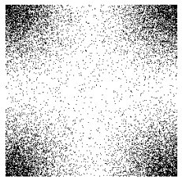
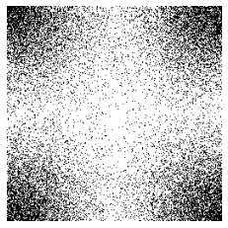
Poisson Mask
Sampling rates:
0.80 0.75

Slide 22
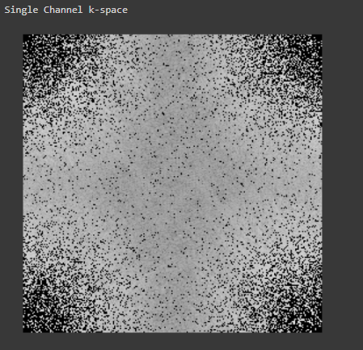
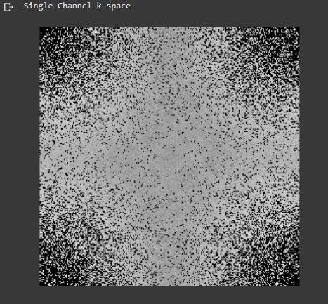
Poisson mask Under-sampling Single-channel k-space
Sampling rates:
0.80 0.75

Slide 23
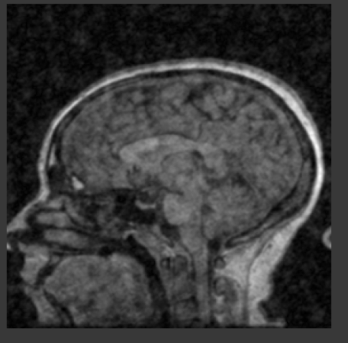
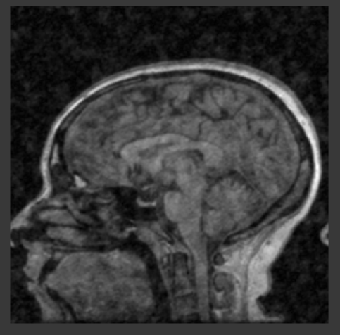
Poisson mask Under-sampling Single-channel k-space
Sampling rates:
0.80 0.75

Slide 24
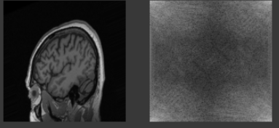
Data Augmentation
ImageDataGenerator (Keras)
Rotates and Shifts the images

Slide 25
Models
Zero Filled Reconstruction
UNET
Hybrid Cascade
W Net

Slide 26
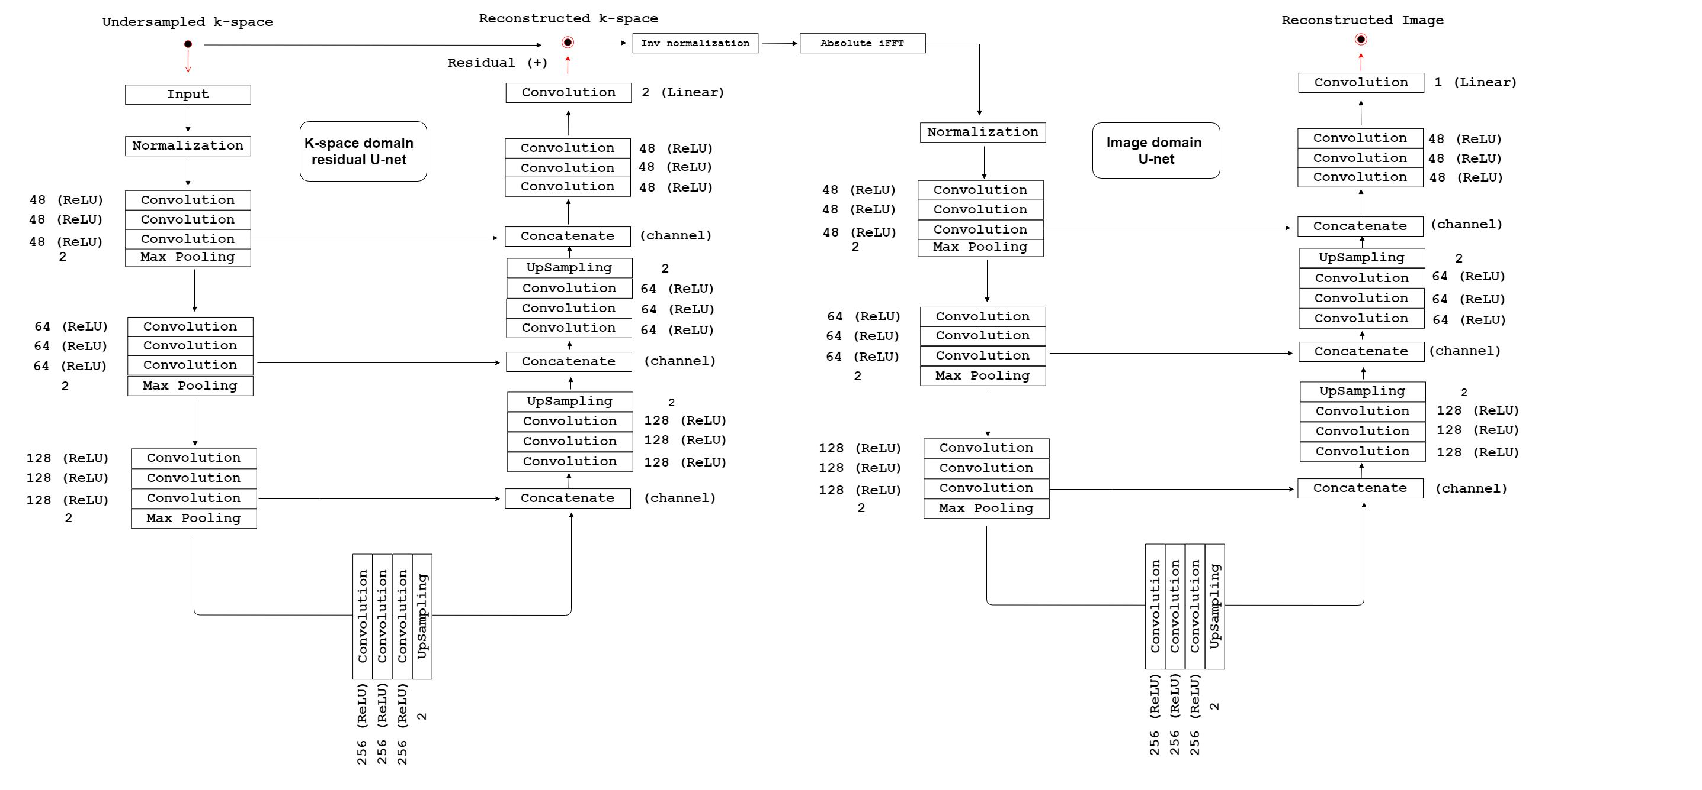
W-net Model

Slide 27
Results

Slide 28
METRICS
Mean Square Error (MSE)
Peak Signal to Noise Ratio (PSNR)
Structural Similarity (SSIM)

Slide 29
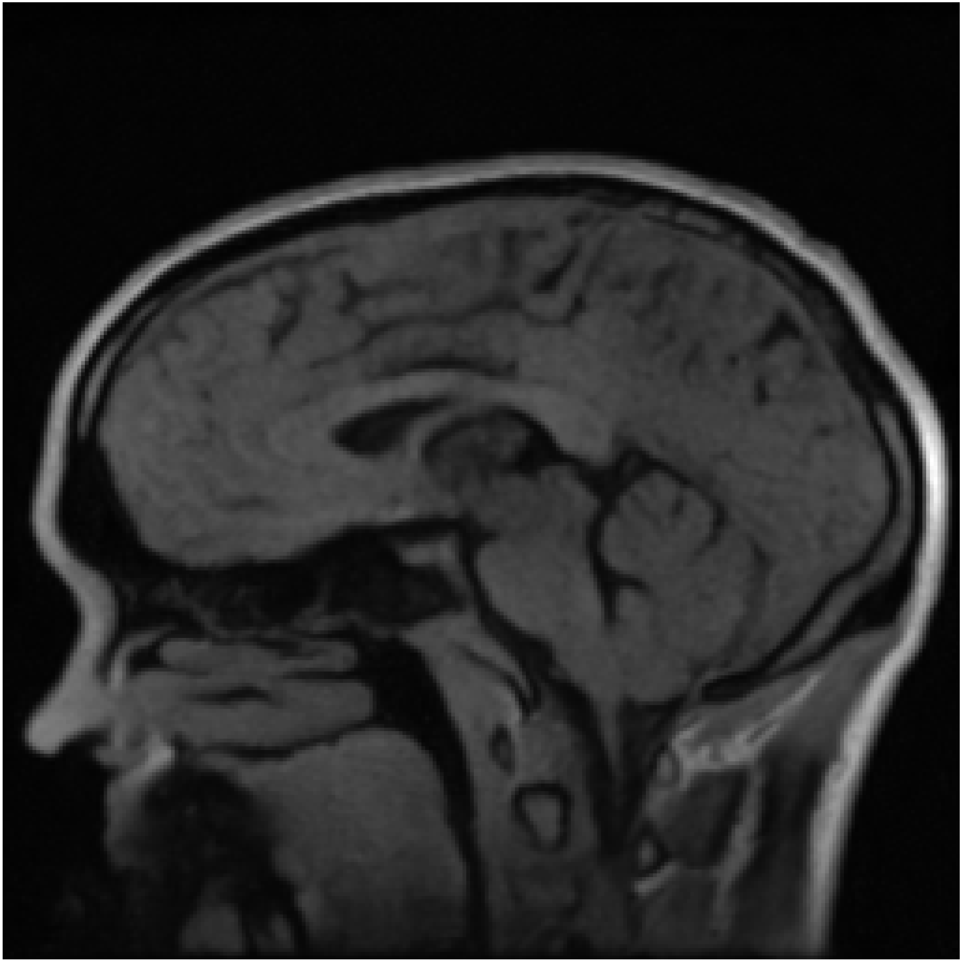
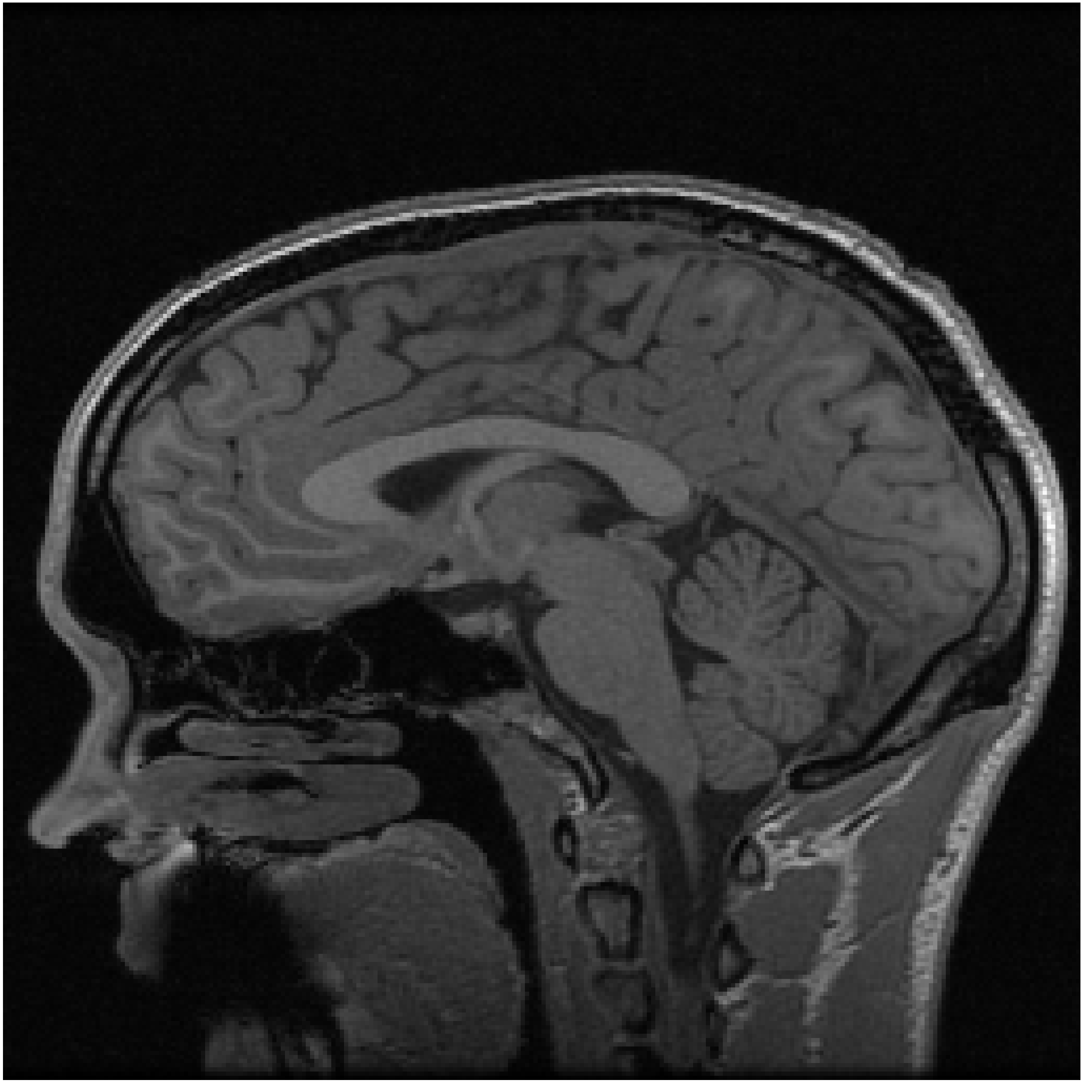
0.80 rate prediction / Fully Sampled
SSIM = 0.85

Slide 30
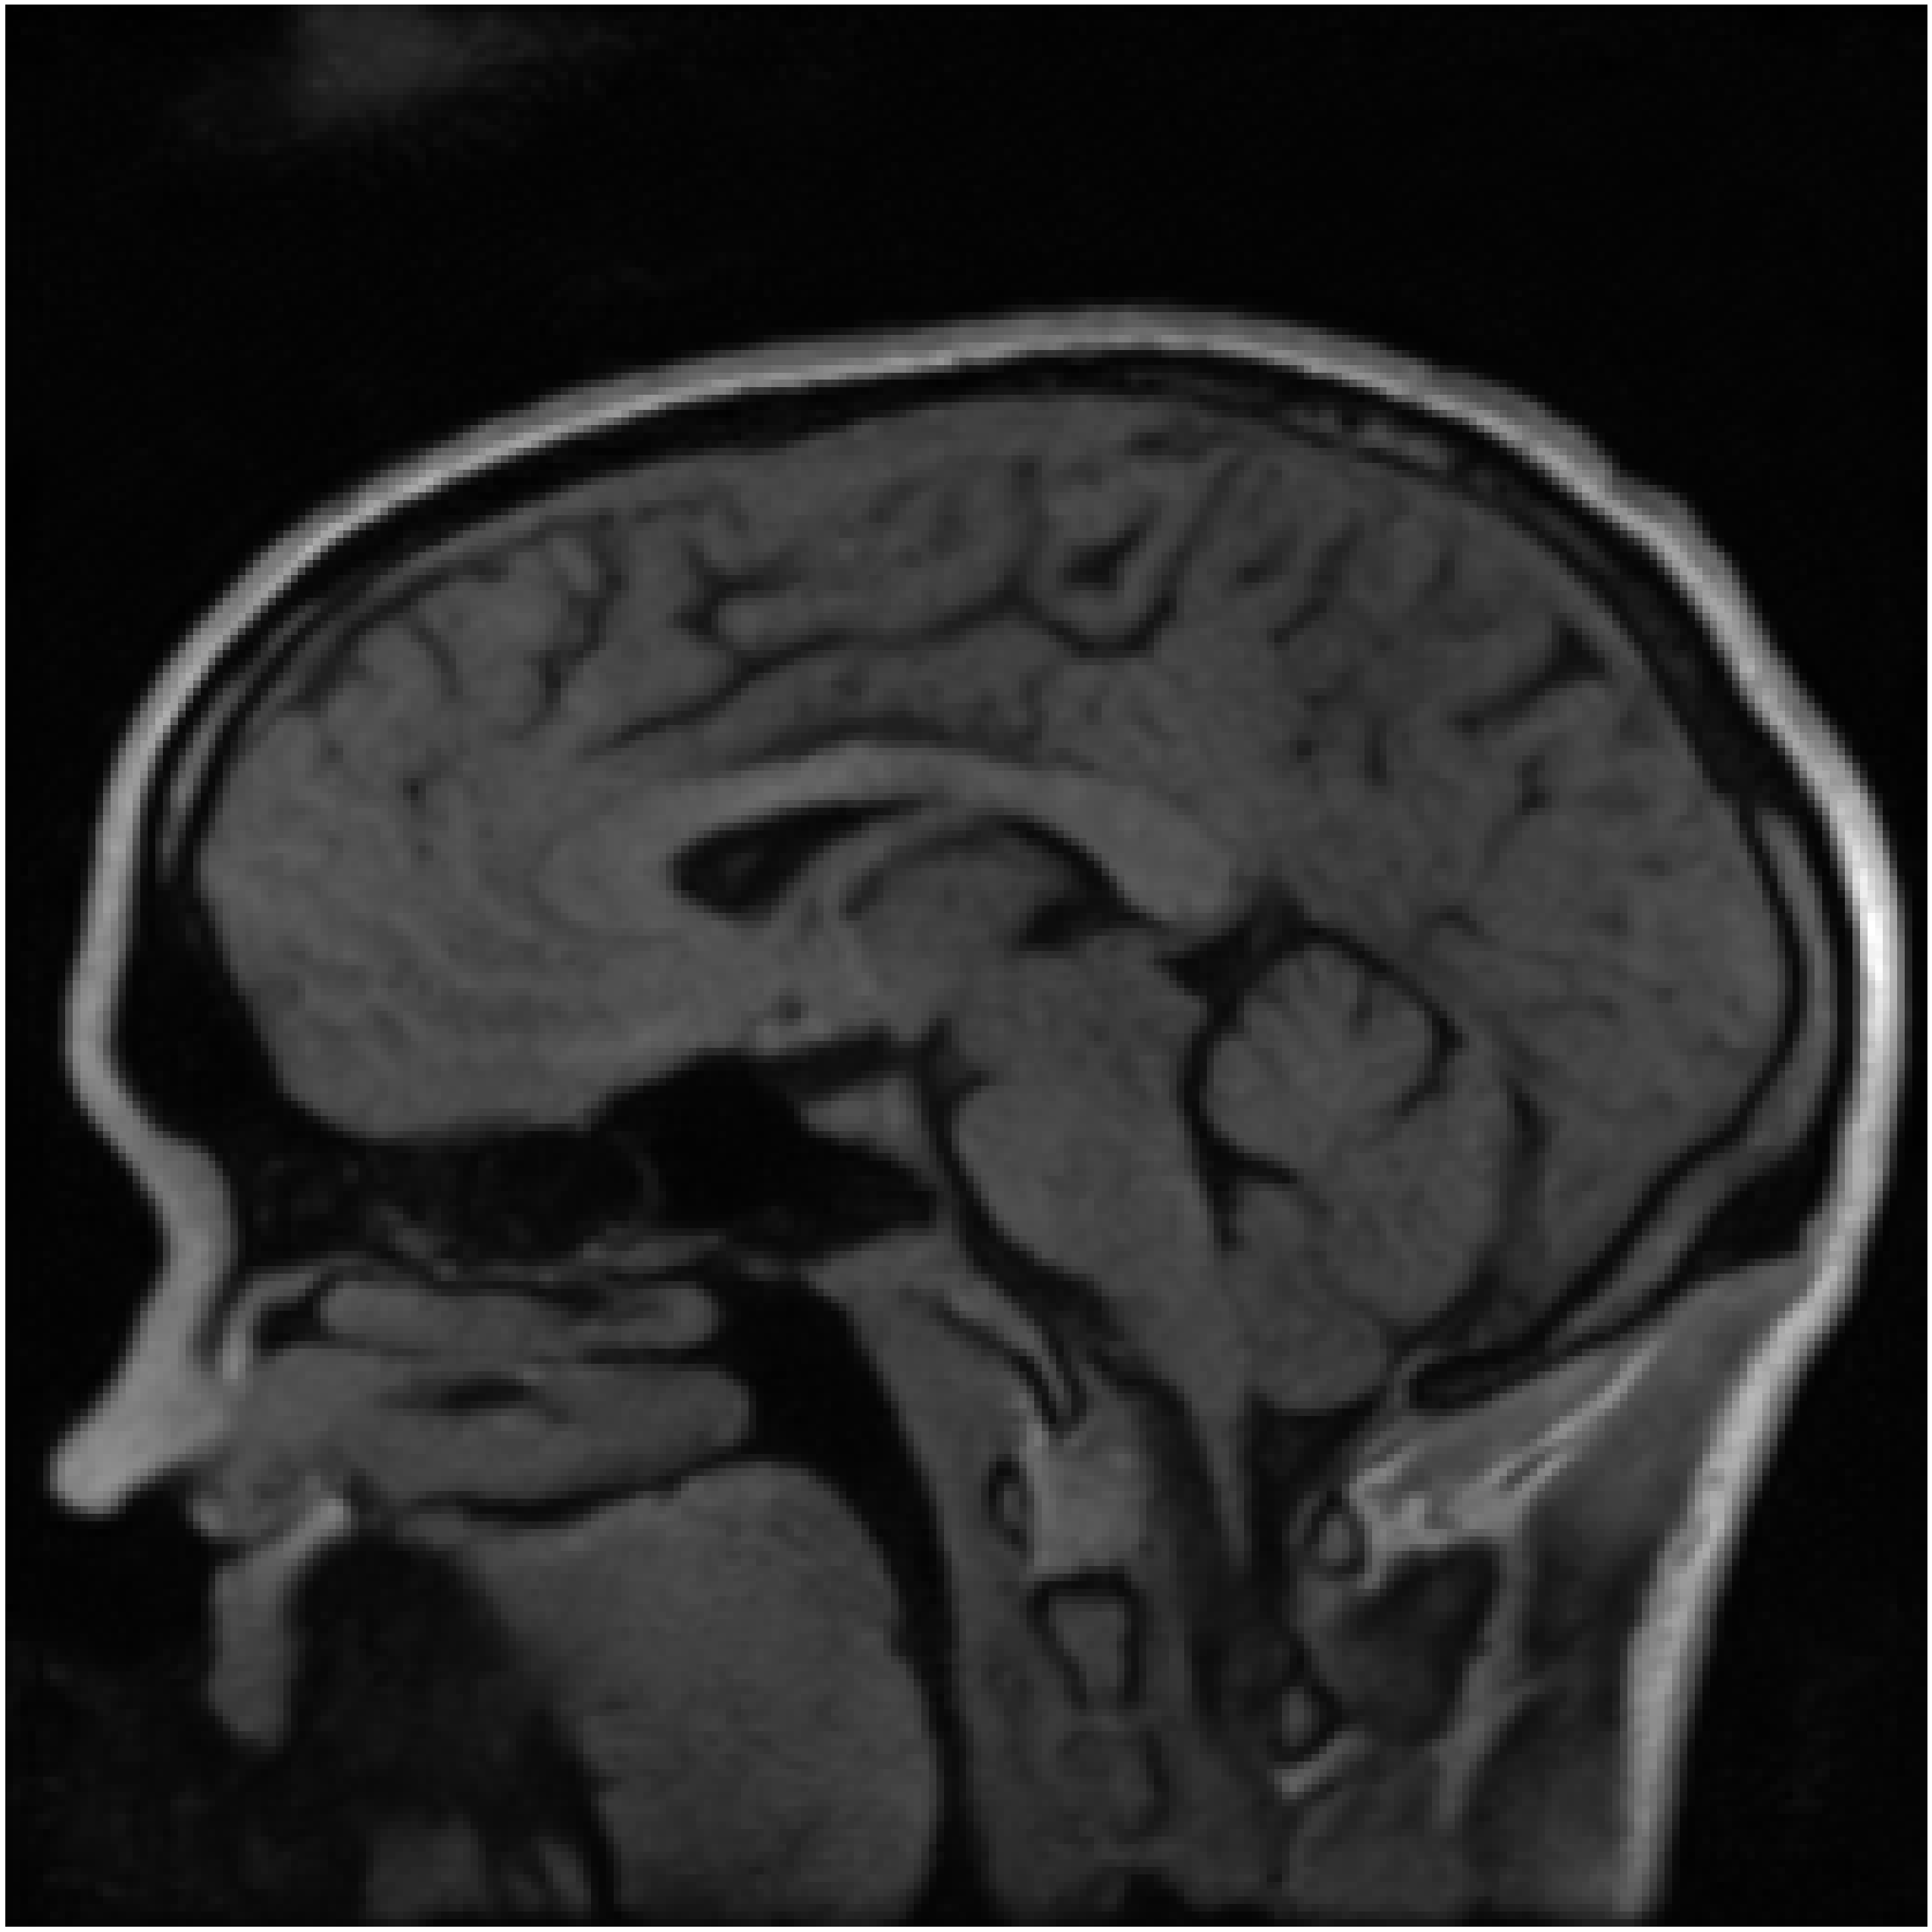
0.75 rate Prediction / Fully Sampled
SSIM = 0.81

Slide 31
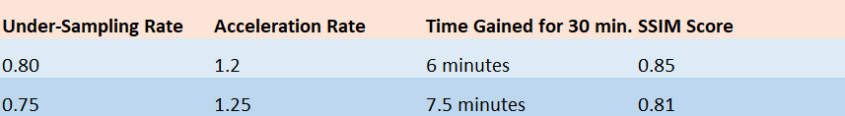
RESULT TABLE

Slide 32
Future Work

Slide 33
Future Work
Reconstructing the W-net model with higher RAM and storage
Hybrid Cascade model, WW-net model
More augmentation
Dual-Channel Data

Slide 34
Thank you

